Slide 1
Bacchus Winery Case Study
Team Indigo || Jacob Ives, Josh Aguilar, Jeff Pederson, Sam Crandall, Kadar Gayle

Slide 2
AGENDA
Group Introduction
Case Study Description
Business Rules
Finalized ERD
Descriptions of reports, and examples of results

Slide 3
Group INTRODUCTION
Team Indigo is made up of Jacob Ives, Josh Aguilar, Jeff Pedersen, Sam Crandall, and Kadar Gayle. We have collaborated to find a solution to the Bacchus Wine case study by implementing a divide and conquer method throughout this project, breaking up the work into two main roles; coding and documenting.

Slide 4
Description of Case Study
Bacchus Winery is a small-scale producer of grapes needed to make a Merlot, Cabernet, Chablis, and Chardonnay. Like many other inherited businesses, the new owners are beginning the process of streamlining their existing data and operations. Three of the main points the company would like to address are listed below:
- Are all suppliers delivering on time? Is there a large gap between expected delivery and actual delivery? A month by month report should show problem areas.
- Are all wines selling as they thought? Is one wine not selling? Which distributor carries which wine?
- During the last four quarters, how many hours did each employee work?
The team's overall goal is to be able to manage key performance indicators more efficiently and we believe they can do that by using a database that houses information related to employees, employee pay, inventory, items, outbound orders, inbound orders, distributors, and suppliers.

Slide 5
Business Rules
An inbound order has one supplier.
Inventory is increased by the number of inbound orders and is specific to the supply_no.
Inventory has all its data (like pricing and name) stored inside the Item table.
When bottles of wine are made internally, inventory would be tracked to reduce the number of supplied parts like bottles, corks, etc, and increase wine stock.
Distributors create outbound_orders that can have many items.
Inventory orders (inbound_orders) have two fields to track delivery time stats; expected_delivery_date and actual_delivery_date. These fields are compared to find and track inbound_orders delivered late.
Contact table houses employee, distributors, and suppliers contact information by distinct contact_id’s.
One employee is associated with one payroll.
One department has many employees and managers.
One employee is associated with many work_hours entries.

Slide 6
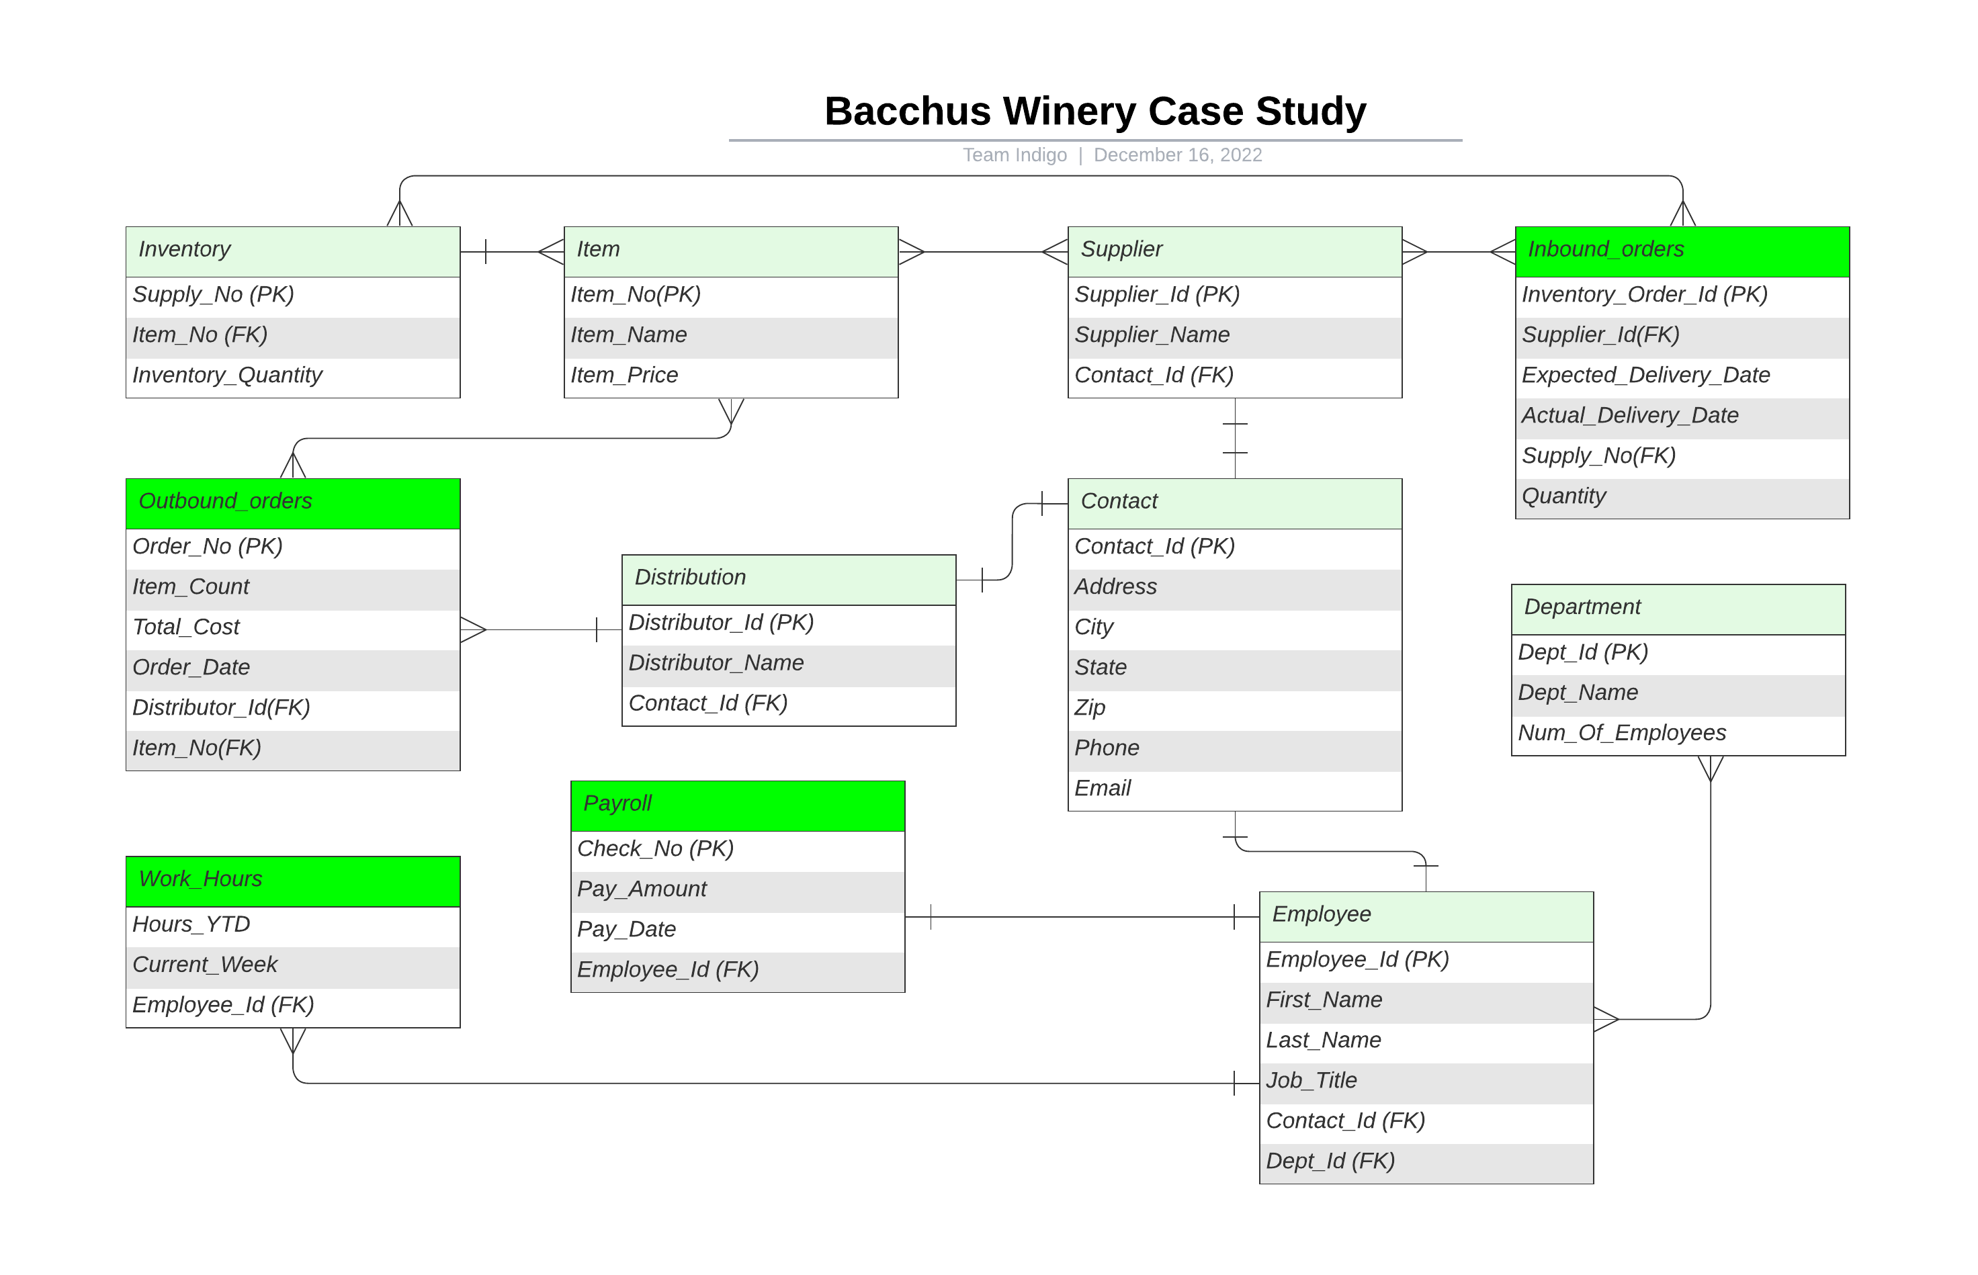
Finalized ERD

Slide 7
Sales Reports
Our first three reports were created to provide solutions for the following questions:
Are all wines selling as they thought?
Is one wine not selling?
Which distributor carries which wine?
Our first report titled, "Distributor_Report.py", was created to address question number three above. It finds and groups the types of wines sold associated with each distributor.
Our second report titled, "Monthly_Sales_Report.py", was created to address question number one above. It finds and groups the total sum of items sold, grouped by year and month.
Our third report titled, "Wine_Sales_Report.py" was created to address question number two above. It finds and groups the total number of wines sold, year-to-date, by type.

Slide 8
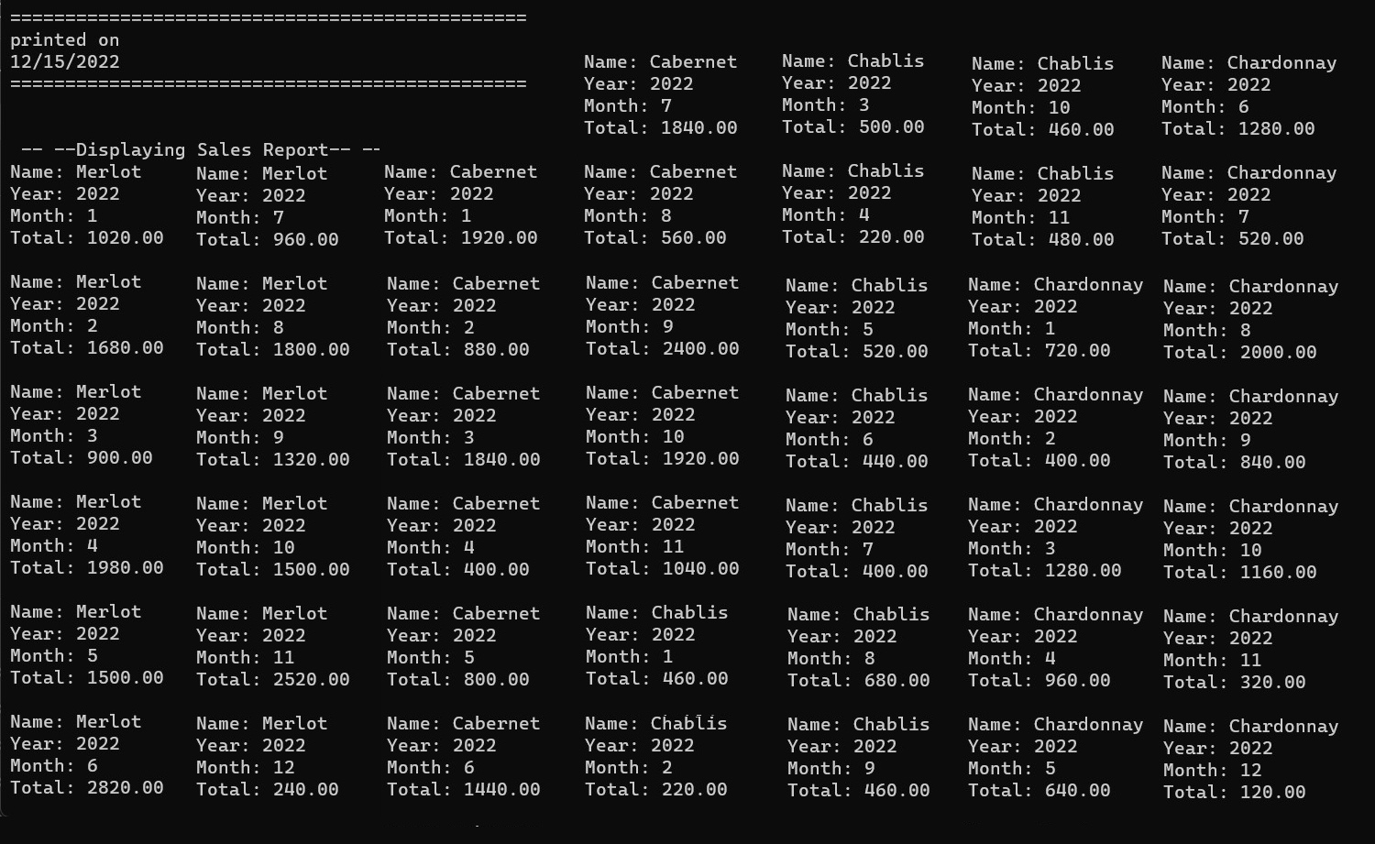
Monthly Sales Report

Slide 9
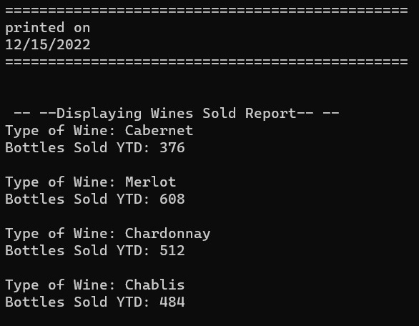
Wine Sales Report

Slide 10
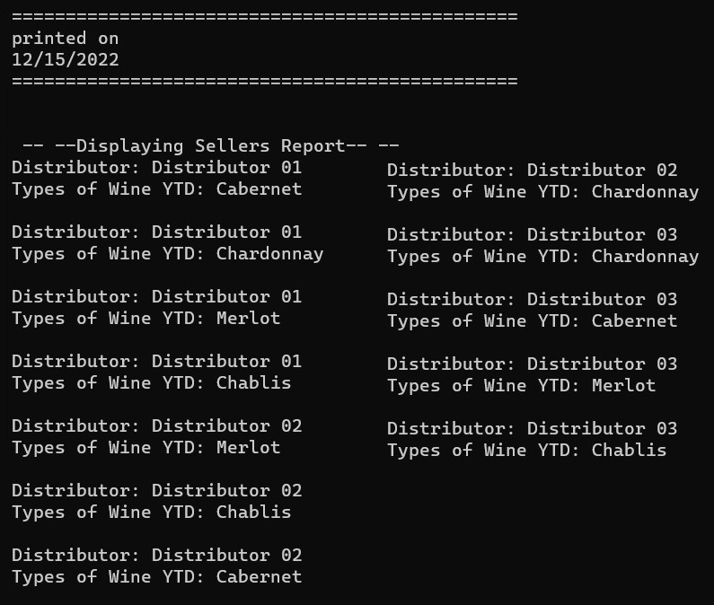
Distributor Sales Report

Slide 11
Delivery Report
Our next report was created to provide a solution for the following two questions:
Are all suppliers delivering on time?
Is there a large gap between expected delivery and actual delivery?
Our report titled, "Delivery_Arrival_Report.py", is written with the purpose of tracking inbound deliveries by month to ensure they are being delivered on time by comparing their expected delivery date to their actual delivery date. Our report titled "Supplier_days_late.py" is written to track how many days each supplier was late vs their number of orders. This helps answer the first question to show which suppliers are arriving later than anticipated more frequently.

Slide 12
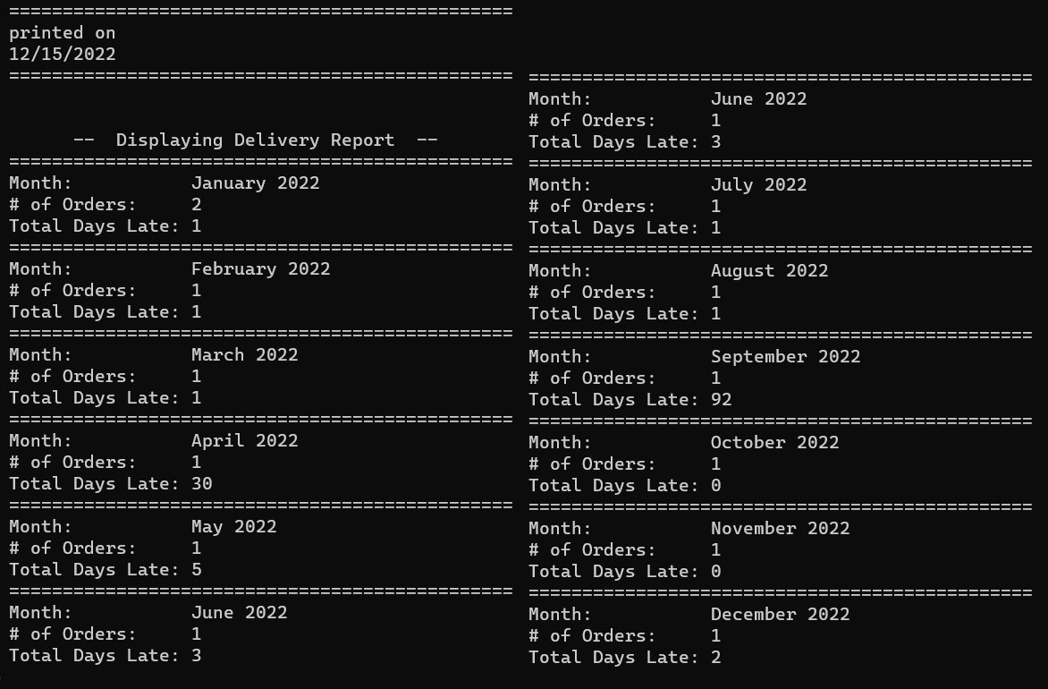
Delivery Report

Slide 13
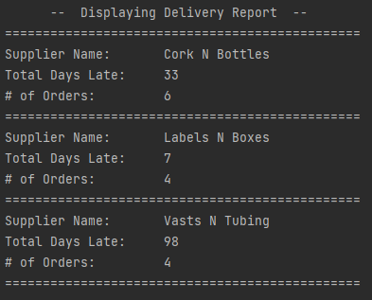
Supplier Report

Slide 14
EMPLOYEE HOURS REPORT
Our final report was created to provide a solution to the following question:
During the last four quarters, how many hours did each employee work?
Our report titled, "Bacchus_Winery_Hours_Report.py", is written with the purpose of showing a workers hours broken down by the current week as well as the current hours worked, year to date.

Slide 15
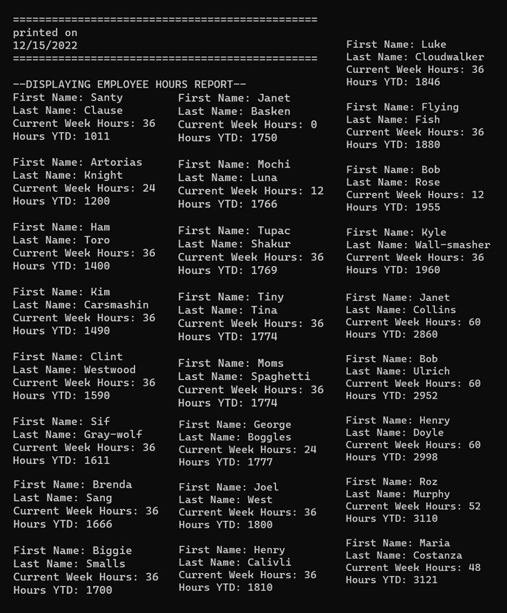
Employee Hours Report

Slide 16
THANK YOU

